Slide 1
How I switched Careers into Software Development in my 30s
She Code Africa International Womens' Day, 2021

Slide 2
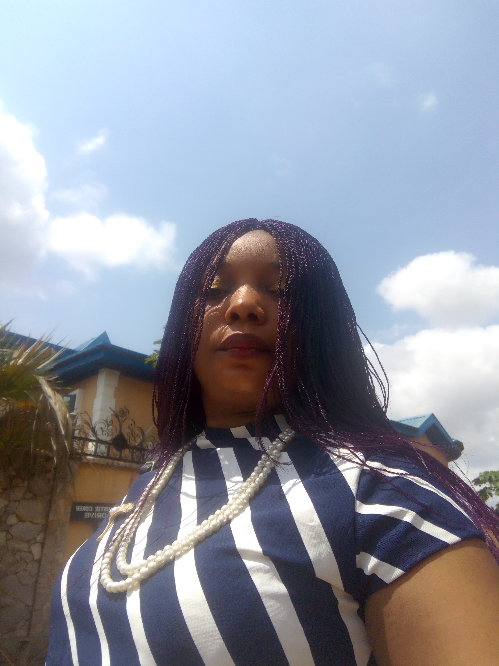
About Me
software developer
fashion designer
speaker
Writer
-Bukola Kehinde

Slide 3
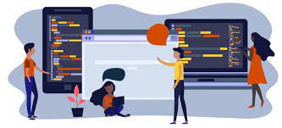
Earlier age
Love drawing/sketching.
Passion for fashion designing.
Male friends who are into web designing.
I took interest in computer programming.
Enrolled into a computer school.
Got certification in basic programming.

Slide 4

Education
Enrolled for a pre medical school.
Study Microbiology at the University.
Did some electives in computer.
Got a shift job as an executive client officer.
Enrolled for a fashion designing training.
Focus on my fashion designing business.

Slide 5

Tech path
My interest grow as my brother who was into tech was changing jobs.
Having the knowledge that IT is the future& I can pass it to my children.
Because of my love for design, I begin to look into the tech space.
I got energized that woman are much encourage to join the tech space.
That I can work remotely.

Slide 6

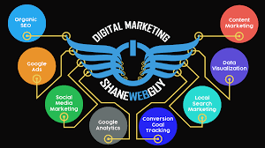

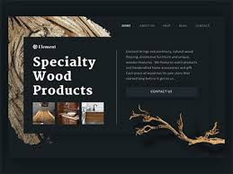
Research path
Social media platforms
Digital marketing
Digital design
Logo making,
Posters making
WordPress
Landing page via WordPress

Slide 7
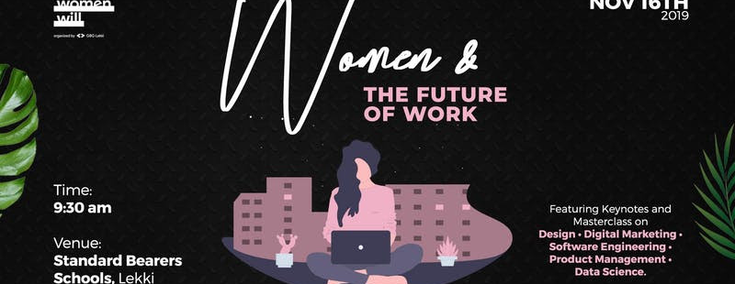
Women & the future work –Google Business Group(GBG)
-organized by Women Will

Slide 8



Study path

Slide 9






Track path

Slide 10
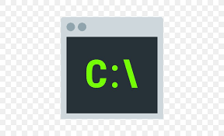





Learning tools

Slide 11


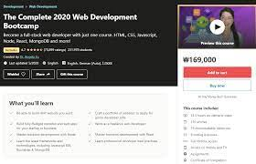
Bootcamp courses

Slide 12



Internship phase

Slide 13

Backend
Curious about how form data are been stored and managed
Wanted to know how APIs are called at the backend
Knowledge about Databases

Slide 14
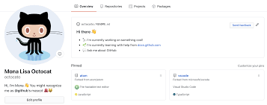
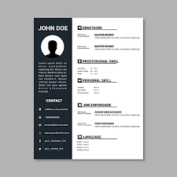

Profile/Resume building
Prepare my CV/Resume.
Update my LinkedIn profile.
Update my GitHub profile.
Portfolio Website.(personal project)

Slide 15



Interview phase

Slide 16



Algorithms & Interview

Slide 17

Advice tips
Encourage Black/Brown women with late-career transition.
Have a strong determination to succeed in your new career.
Research and focus on a particular tech area.
Embrace the truth of who you are, your maturity & experience is an advantage.
Try to repackage your past experience to fit your current tech space.
Prove that you can be part of a team technically.
Get involved with open source.
Follow me @ twitter.com/bukola14_bukola

